Slide 1
19-12-2022
SUPERVISORS
STUDENT
Erasmus Medical Centre
Iris Lansdorp-Vogelaar, Rosita van den Puttelaar, and Danica van den Berg
Yoëlle Kilsdonk
513530
Thesis presentation:
Simulating Haemoglobin Concentrations for MISCAN-Colon Using Black-box Machine Learning as a Step Towards Personalised Colorectal Cancer Screening
Notes:
Welcome everyone, and thanks for coming. Today I will be presenting my thesis project, which is called "...".

Slide 2
Table of
Contents
Page
I
Research question
1
II
Data
2
III
Methodology
6
IV
Research results
19
V
Conclusion
28
VI
Discussion
30
Notes:
I will first present the research questions, followed by a description of the data, methodology, results, and finally a discussion where I have a question for you, and of course I also welcome questions you have for me!

Slide 3

I
Research Questions
Do black-box machine learning models perform well in the prediction of haemoglobin concentrations?die
Do mixed-effects machines learning models perform better?
1
Notes:
In my research I tried to find models to predict haemoglobin concentrations in an individual, and since black-box machine learning models have a long-standing reputation of high performance, I really wanted to look at their performance on the EMC data that I was provided with. Additionally, due to the longitudinal nature of the data, I also wanted to look at a mixed-effects version of these machine learning models, which leads to the research questions:

Slide 4

II
Data
EMC provided data set (RIVM)
Age, sex, birth year, current round, maximum/previous/current haemoglobin concentration, and stage of lesions
6.8 million observations
2014-2020 (biennial)
2
Notes:
Now, the main data set that we used in this research, was provided by EMC. It contains information on all variables that you see on the screen right here, so: ...
It amounts to almost 7 million observations, for 3.2 million individuals, which are obtained biennaly from 2014-2020.

Slide 5

II
Data
Data characteristics
Missing values
Longitudinal
Zero inflation
3
Notes:
And in this data set are three important data characteristics that I want to discuss: first are missing values, second is the fact that the data is longitudinal, and lastly the zero inflation in the dependent variable.

Slide 6
II
Data
Data characteristics
Missing values
Longitudinal
Zero inflation
3
Notes:
Let's start with missing values.

Slide 7

II
Data
Missing values
Stage: healthy / non-advanced adenoma / advanced adenoma / colorectal cancer
Only known if FIT result positive (hb > 47)
Colonoscopy
3.9% of observations
4
Notes:
All variables in our data set are complete, except for the stage variable. The stage variable shows the current stage of lesion in an individual, ranging from healthy to non-advanced adenoma, advanced adenoma, and colorectal cancer. This variable is only known when an individual undergoes a colonoscopy, which only happens when the FIT result is positive. For our data set, only 3.9% of observations had a positive test outcome, which means that 96.1% of observations in stage are missing. How did we account for those missing values you ask?

Slide 8

II
Data
Missing values
Stage: healthy / non-advanced adenoma / advanced adenoma / colorectal cancer
Only known if FIT result positive (hb > 47)
Colonoscopy
3.9% of observations
Data imputation
4
Notes:
Well, through data imputation.

Slide 9


II
Data
Multiple Imputation via Chained Equations
Fits regression models to predict missing values of stage (96.1%) using the variables FIT result, age, sex, haemoglobin concentration and the known observations of stage (3.9%)
5
Notes:
Specifically, we use the approach by van Buuren, called multiple imputation via chained equations. This method works by fitting a series of regression models to the data, where we impute the missing observations in stage, using the known variables ... without missing values, and the known observations of stage. Now, I can hear you thinking: do you really think it's best practice to only use 3.9% of observations to impute one of the most influential variables in your data set? Well, no.

Slide 10
II
Data
Multiple Imputation via Chained Equations
Fits regression models to predict missing values of stage (96.1%) using the variables FIT result, age, sex, haemoglobin concentration and the known observations of stage (3.9%)
Additional data sets
Simulation data set
Second EMC provided data set
5
Notes:
Which is why we temporarily added in a second and third data set to help with the predictions of the missing values. Specifically, we used a simulation data set from MISCAN colon, and we used a second EMC provided data set, where the threshold of a positive FIT result was lower, such that the stage was known more often. You don't have to understand entirely how this algorithm works, you just have to know that once this step is done, we have a complete data set without missing values.

Slide 11
Table of
Contents
Page
I
Research question
1
II
Data
2
III
Methodology
6
IV
Research results
19
V
Conclusion
28
VI
Discussion
30
Notes:
And now that we have a complete data set, let's look at what models we will be using to estimate the haemoglobin concentration in this data.

Slide 12



III
Methodology
XGBoost
Artificial Neural Networks
XGBoost with RMSE as objective function
XGBoost Mixed-effects
XGBoost with Tweedie Loss as objective function
ANN with RMSE as objective function
ANN Mixed-effects
6
Notes:
In this research we consider two different types of models: extreme gradient boosting and artificial neural networks. Let me start by briefly explaining how both methods work, beginning with XGBoost.

Slide 13

III
Methodology
XGBoost
Fit model to the data
Build a shallow regression tree
Goal? Decrease error from previous prediction
How? Train current tree on errors of previous tree
Make new prediction as: previous prediction + ε * XGBoost prediction
Determine the error of new prediction
Sequentially repeat steps 2 - 4
7
Notes:
The XGBoost algorithm is an ensemble algorithm, which basically uses shallow regression trees in a sequential manner to improve previous predictions. If we look at the step-by-step explanation on the screen, you can see that it works as follows:

Slide 14
III
Methodology
XGBoost
Fit model to the data
Build a shallow regression tree
Goal? Decrease error from previous prediction
How? Train current tree on errors of previous tree
Make new prediction as: previous prediction + ε * XGBoost prediction
Determine the error of new prediction
Sequentially repeat steps 2 - 4
7
Notes:
First, we make in initial prediction. This prediction can be anything, it can be the mean, median, just zeros, whatever, it doesn't matter. All that matters is that once we've made our initial predictions, we can calculate the error. That's step one.

Slide 15
III
Methodology
XGBoost
Fit model to the data
Build a shallow regression tree
Goal? Decrease error from previous prediction
How? Train current tree on errors of previous tree
Make new prediction as: previous prediction + ε * XGBoost prediction
Determine the error of new prediction
Sequentially repeat steps 2 - 4
7
Notes:
Then, in step 2, we build a shallow regression tree, but we do not fit this tree on the data, as we did in step 1. Instead, we fit the tree on the error of the previous tree. In doing so, we ensure that the loss function of the current prediction plus the previous prediction is lower, than the loss function of only the previous prediction.

Slide 16
III
Methodology
XGBoost
Fit model to the data
Build a shallow regression tree
Goal? Decrease error from previous prediction
How? Train current tree on errors of previous tree
Make new prediction as: previous prediction + ε * XGBoost prediction
Determine the error of new prediction
Sequentially repeat steps 2 - 4
7
Notes:
Then in step three, we create the boosted counterpart of the initial prediction, through adding the initial prediction of step 1 to the XGBoost prediction of step 2 times a certain learning rate.

Slide 17
III
Methodology
XGBoost
Fit model to the data
Build a shallow regression tree
Goal? Decrease error from previous prediction
How? Train current tree on errors of previous tree
Make new prediction as: previous prediction + ε * XGBoost prediction
Determine the error of new prediction
Sequentially repeat steps 2 - 4
7
Notes:
Then, in step four, we simply determine the error of the new prediction, ...

Slide 18
III
Methodology
XGBoost
Fit model to the data
Build a shallow regression tree
Goal? Decrease error from previous prediction
How? Train current tree on errors of previous tree
Make new prediction as: previous prediction + ε * XGBoost prediction
Determine the error of new prediction
Sequentially repeat steps 2 - 4
7
Notes:
and the process repeats itself until a certain stopping criterium.
And this clearly shows how XGBoost attains its goal: we sequentially add weak learners, that predict better and better with each iteration, until we are left with a strong learner with a low loss function.

Slide 19
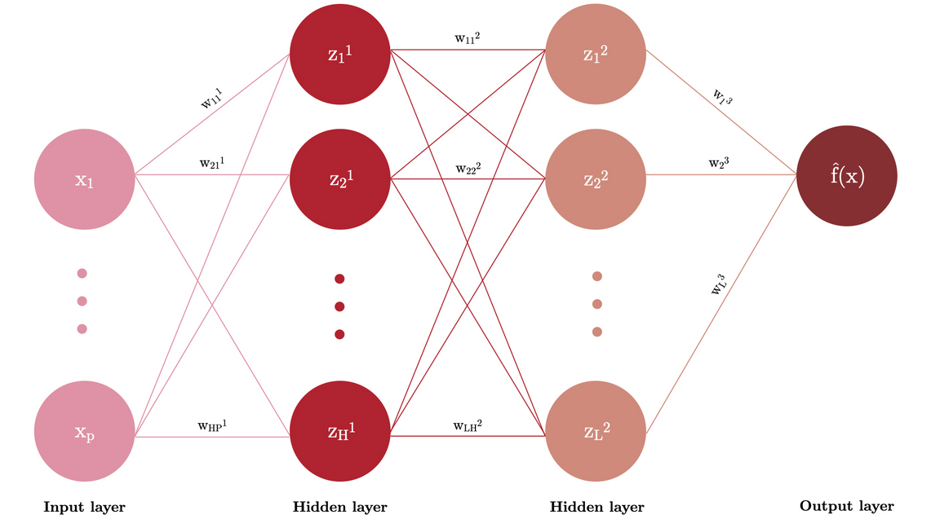
III
Methodology
Artificial Neural Networks
Provide data in the input layer.
Data progresses to first hidden layer.
Non-linear relations in the data through activation functions
Data progresses to a second hidden layer.
Results in one output node.
8
Notes:
Now that you're an expert in XGBoost, let's also quickly make you an expert in neural networks. This algorithm is maybe a bit more straightforward to explain. and I think the easiest way to understand it, is through comparing the algorithm to our own brain.
Because in our brain, every action starts with an impulse to a neuron. The neuron then does something with it, and sends it to another neuron, until eventually it results in an action. Now if we translate this to a data problem, we get the following:

Slide 20

III
Methodology
Artificial Neural Networks
Provide data in the input layer.
Data progresses to first hidden layer.
Non-linear relations in the data through activation functions
Data progresses to a second hidden layer.
Results in one output node.
8
Notes:
We first feed our data to the input layer, which is the start of our model. So, this is where we tell the model the age, sex, birth year etcetera of all observations.

Slide 21
III
Methodology
Artificial Neural Networks
Provide data in the input layer.
Data progresses to first hidden layer.
Non-linear relations in the data through activation functions
Data progresses to a second hidden layer.
Results in one output node.
8
Notes:
and then data then progresses to the first hidden layer. And this is where ANN really gets interesting, because hidden layers can be used to find non-linear relations in the data, which is done through applying a non-linear activation function over the input data.
Once we've done that, we precede to a second hidden layer ...

Slide 22
III
Methodology
Artificial Neural Networks
Provide data in the input layer.
Data progresses to first hidden layer.
Non-linear relations in the data through activation functions
Data progresses to a second hidden layer.
Results in one output node.
8
Notes:
and the main reason that we do so, is because some research finds that ANNs with two hidden layers may be more efficient than an ANN with one hidden layer. But the mathematical explanation of that goes beyond the scope of this presentation.
We just need to know, that once the data has been fed through the first two hidden layers, the model combines all information into one final output node. ...

Slide 23
III
Methodology
Artificial Neural Networks
Provide data in the input layer.
Data progresses to first hidden layer.
Non-linear relations in the data through activation functions
Data progresses to a second hidden layer.
Results in one output node.
8
Notes:
which is the predicted haemoglobin concentration in our case. And that's it!

Slide 24

III
Methodology
Data characteristics
Missing values
Longitudinal
Zero inflation
9
Notes:
Now that we've covered the missing values and we know how to make predictions using XGBoost and ANN, I want to touch upon the longitudinal nature of our data.

Slide 25

III
Methodology
Mixed-effects Machine learning
Longitudinal data
Time dimension & individual dimension
Intra individual correlation
Violation of i.i.d. assumption
10
Notes:
For those who don't know, data is considered to be longitudinal when it has a time and individual dimension. That is, for an individual A, we might have observations for time period t, t+2, and t+4. And for individual B might have observations from time period t only.
Now, a 'normal' data set, often consist of points that are identically independently distributed. Which is a nice assumption we like to make in machine learning, to make valid inferences. However, from our data it would make sense to think that the current haemoglobin concentration of an individual is correlated with previous haemoglobin concentrations. And if that's the case, we violate this assumption.
Now you might be wondering how we will account for the possible violation of this assumption then, and the answer is: through mixed-effects machine learning.

Slide 26
III
Methodology
Mixed-effects Machine learning
Splits prediction into fixed-effects + random-effects
Fixed-effects the same over all individuals
Random-effects individual specific
Alternatively estimated
11
Notes:
In mixed-effects machine learning we split the prediction into two parts: a fixed-part (green) and a random part (blue). The fixed-part is the same over all individuals, and the random-effects are individual specific.
The reason that this is appropriate to use in our setting, is because if there are indeed intra correlations between individuals, the only way we can make for valid inference, would be to explicitly model this relation, which is exactly the role the the random-effects play.

Slide 27

III
Methodology
Mixed-effects Machine learning
Initiate random effects at zero
Use machine learning model to estimate y := the fixed effects
Use a Linear Mixed Effects model and the estimated fixed effects from step 2 to estimate random effects
Create adjusted target variable := y - random effects
Repeat steps 2-4 with adjusted target variable
12
Notes:
Now, if we want to get a bit more technical: the way mixed-effects machine learning works is as follows.

Slide 28
III
Methodology
Mixed-effects Machine learning
Initiate random effects at zero
Use machine learning model to estimate y := the fixed effects
Use a Linear Mixed Effects model and the estimated fixed effects from step 2 to estimate random effects
Create adjusted target variable := y - random effects
Repeat steps 2-4 with adjusted target variable
12
Notes:
We first initiate the random effects at zero.

Slide 29
III
Methodology
Mixed-effects Machine learning
Initiate random effects at zero
Use machine learning model to estimate y := the fixed effects
Use a Linear Mixed Effects model and the estimated fixed effects from step 2 to estimate random effects
Create adjusted target variable := y - random effects
Repeat steps 2-4 with adjusted target variable
12
Notes:
Then, in step two, we use a machine learning model, such as XGBoost or ANN in our case, to estimate the dependent variable. So, in this step we estimate the fixed effects.

Slide 30
III
Methodology
Mixed-effects Machine learning
Initiate random effects at zero
Use machine learning model to estimate y := the fixed effects
Use a Linear Mixed Effects model and the estimated fixed effects from step 2 to estimate random effects
Create adjusted target variable := y - random effects
Repeat steps 2-4 with adjusted target variable
12
Notes:
Note that these first two steps are identical to just using a regular machine learning model to estimate the dependent variable. The difference between mixed-effects and regular machine learning only begin from step 3 onward.

Slide 31
III
Methodology
Mixed-effects Machine learning
Initiate random effects at zero
Use machine learning model to estimate y := the fixed effects
Use a Linear Mixed Effects model and the estimated fixed effects from step 2 to estimate random effects
Create adjusted target variable := y - random effects
Repeat steps 2-4 with adjusted target variable
12
Notes:
And in step 3, we use a linear mixed effects model and the estimated fixed effects from step 2 to estimate, and therefore update, the random effects.

Slide 32
III
Methodology
Mixed-effects Machine learning
Initiate random effects at zero
Use machine learning model to estimate y := the fixed effects
Use a Linear Mixed Effects model and the estimated fixed effects from step 2 to estimate random effects
Create adjusted target variable := y - random effects
Repeat steps 2-4 with adjusted target variable
12
Notes:
Once we have the updated random effects, we create an adjusted target variable, which is equal to the true target variable minus the random effects. ...

Slide 33
III
Methodology
Mixed-effects Machine learning
Initiate random effects at zero
Use machine learning model to estimate y := the fixed effects
Use a Linear Mixed Effects model and the estimated fixed effects from step 2 to estimate random effects
Create adjusted target variable := y - random effects
Repeat steps 2-4 with adjusted target variable
12
Notes:
and this process repeats itself, until the gain in generalised log-likelihood is lower than a predetermined small value.

Slide 34
III
Methodology
XGBoost
Artificial Neural Networks
XGBoost with RMSE as objective function
XGBoost Mixed-effects
XGBoost with Tweedie Loss as objective function
ANN with RMSE as objective function
ANN Mixed-effects
13
Notes:
So, once we've reached the stopping criterium, we have our mixed-effects machine learning predictions.
And with that, we only have one final model left to discuss.

Slide 35
III
Methodology
Data problems
Missing values (96.1%)
Longitudinal
Zero inflation
14
Notes:
This fifth model is a result of our third, and final data characteristic: zero-inflation.

Slide 36
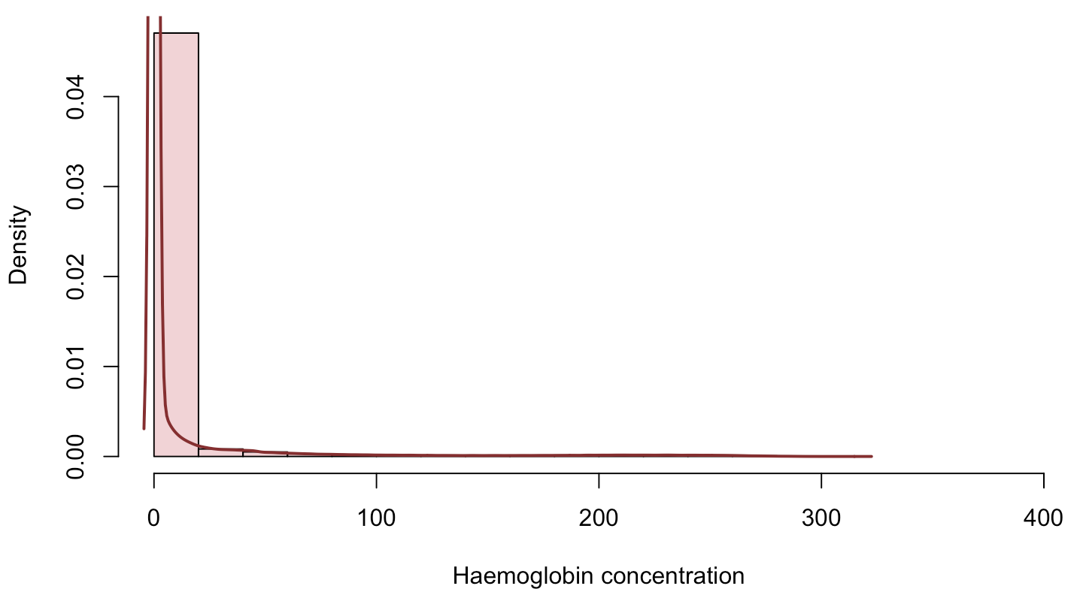
III
Methodology
Haemoglobin concentration
RMSE
Symmetric penalty non-zero vs zero observations
15
Notes:
This histogram shows the haemoglobin concentration in the data set. We can clearly see that the vast majority of observations are zeroes. And we would like for our models to understand this data characteristic.
I havent touched on it yet, but in all the previous models that I discussed, we use the root mean squared error as objective function to minimise. Now let's zoom in on how this loss function penalises wrong predictions.

Slide 37
III
Methodology
RMSE
Symmetric penalty non-zero vs zero observations
True = 0 | predicted = 50
True = 50 | predicted = 100
16
Notes:
The RMSE loss function, is symmetric, which means thatthe penalty of predicting a value of 50, when the true value is 0, is equal to the penalty of predicting a value of 100 when the true value is 50.
However, it might not be a good idea to use a loss function that's generally used for Gaussian distributions, as loss function for a heavily zero-inflated distribution.

Slide 38
III
Methodology
RMSE
Tweedie Loss
Symmetric penalty non-zero vs zero observations
Penalty for non-zero predictions when true value is zero > penalty for wrong predictions for non-zero observations
True = 0 | predicted = 50
True = 50 | predicted = 100
True = 0 | predicted = 50
True = 50 | predicted = 100
17
Notes:
This is where the Tweedie loss comes in. This is an asymmetrical loss function, which puts a higher penalty on wrongly predicting a non-zero value for a true value of zero, than if the true value is non-zero.

Slide 39
III
Methodology
XGBoost
Artificial Neural Networks
XGBoost: XGBoost with RMSE as objective function
MeXGBoost: XGBoost Mixed-effects
Tweedie XGBoost: XGBoost with Tweedie Loss as objective function
ANN: ANN with RMSE as objective function
MeANN: ANN Mixed-effects
18
Notes:
Okay, so we've discussed on all our data problems, and we know all there is to know about XGBoost, ANN and mixed-effects models. This leaves us with these five models: XGBoost, MeXGBoost, Tweedie XGBoost, ANN and MeANN.

Slide 40
Table of
Contents
Page
I
Research question
1
II
Data
2
III
Methodology
6
IV
Research results
19
V
Conclusion
28
VI
Discussion
30
Notes:
Now I before I continue to the research results, do you have any burning questions, which you'd like for me to answer now?
If not, I will continue!

Slide 41
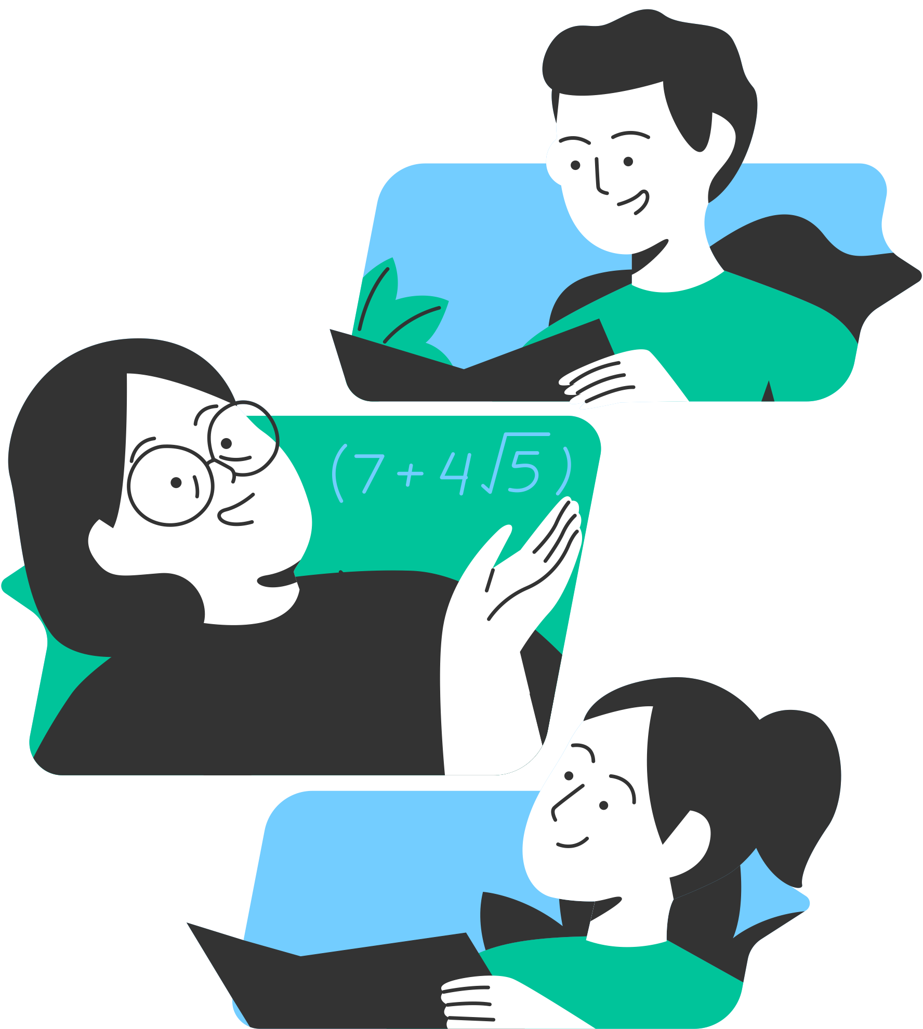
IV
Research Results
Similarities
> 90% of true dependent variable lies between [0; 25]
> 95% of these points correctly predicted
No correct predictions when true dependent variable > 225
Underpredicting when true dependent variable > 50
Same trend
Differences
Added value of mixed-effects
19
Notes:
First off, spoiler alert, the performance of the models are relatively similar across the board, which is why I've decided to split up the results into similarities which hold across all models, and differences between these models.

Slide 42
IV
Research Results
Similarities
> 90% of true dependent variable lies between [0; 25]
> 95% of these points correctly predicted
No correct predictions when true dependent variable > 225
Underpredicting when true dependent variable > 50
Same trend
Differences
Added value of mixed-effects
19
Notes:
Let's start with discussing these similarities.

Slide 43
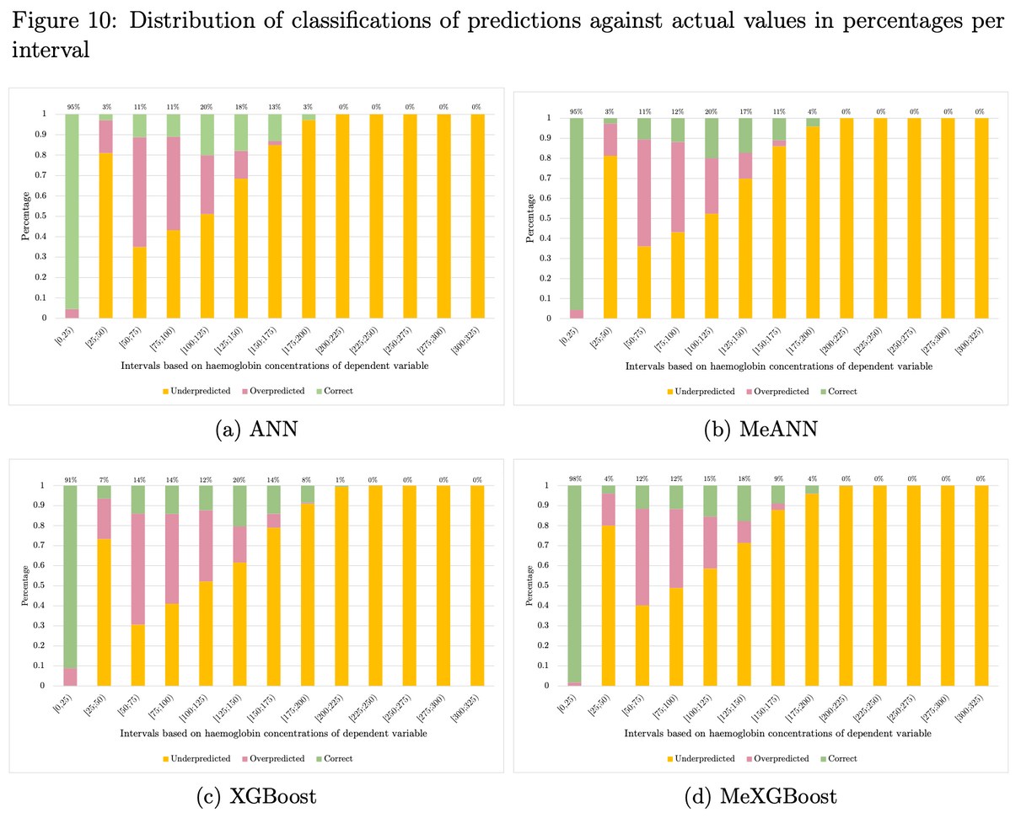
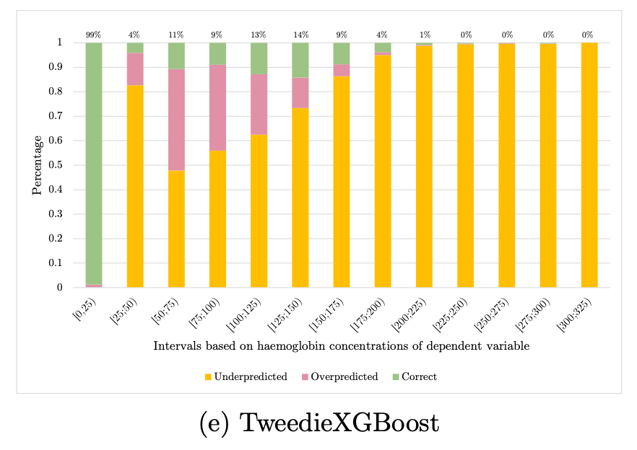
IV
Research Results
20
Notes:
These figures show the distribution of classifications of predictions against true values in percentages per interval. So what we did, was we sorted the true dependent variable into buckets with width 25, and we evaluated the predictions per bucket. Green represents the share of points that are correctly predicted, yellow is indicative of under prediction and pink denotes over prediction. As you can see, the figures are extremely similar over all 5 models, so let's zoom in on one.

Slide 44
IV
Research Results
> 90% of true dependent variable lies between [0; 25]
> 95% of these points correctly predicted
No correct predictions when true dependent variable > 225
21
Notes:
We know from the histogram that I've shown before, that the vast majority of points are zero, and therefore lie in the first interval. And the fact that the first interval is almost entirely green indicates that all of our models perform really well in this interval, with correct classifications for more than 95% of observationsa across all models. So the models are really accurate for the vast majority of our observations.
On the flip side, however, our models hardly produce any correct predictions once the dependent variable exceeds 225. Which can be seen from the 5 bars on the most right being (almost) entirely yellow.

Slide 45
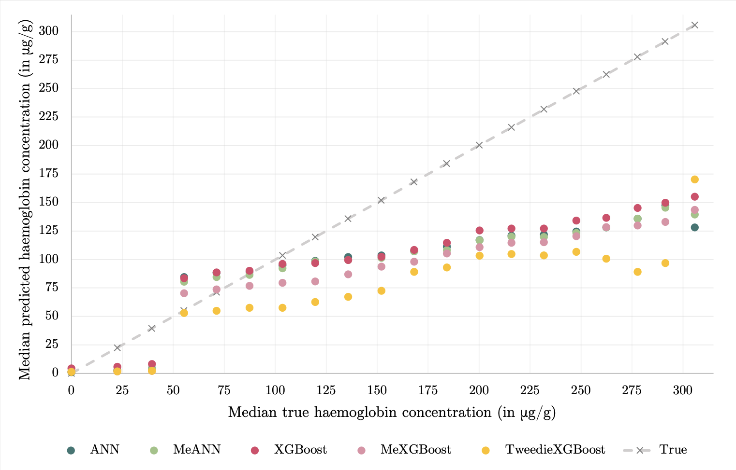
IV
Research Results
No correct predictions when true dependent variable > 225
Underpredicting when true dependent variable > 50
Same trend
22
Notes:
This relates to the next two similarities which I want to discuss. Because when we plot the median predicted values against the median true values, we see that our models already start to under predict once the true value exceeds approximately 50.
That is, in the best case scenario our models would lie on the gray 45 degree line, which is when predictions are exactly equal to the true values. But we clearly see that our models drop beneath this 'perfect' line more and more as the dependent variable increases. It seems that our models are not able to accurately predict any values over approximately 150 at all.
The only reason I can think of for why our models seem to cap around 150, is the following. ...

Slide 46
IV
Research Results
23
Notes:
Recall our histogram from a few slides ago.

Slide 47
III
Research Results
23
Notes:
If we zoom in on this area where the FIT is positive, so where the dependent variable exceeds 47, we see the following histogram:

Slide 48
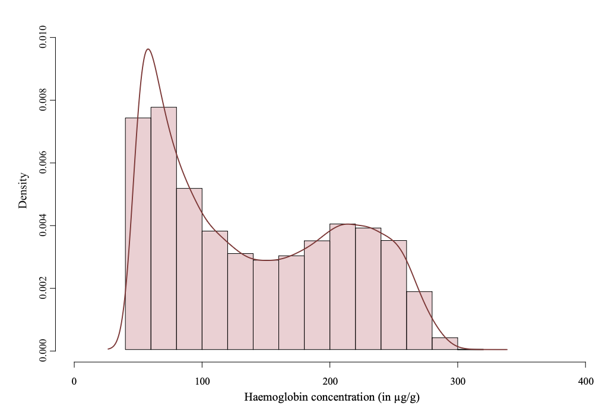
IV
Research Results
24
Notes:
What we can see, is that the distribution of haemoglobin concentration in these positive FITS is bimodal, with a first peak around [50;150] and a second peak from [150;300]. And I think that the models that I introduced today, just didn't catch the second peak. Which could be for a multitude of reasons.

Slide 49
IV
Research Results
Share of observations for which hb > 150 incredibly small
Mistaken for noise
Not enough samples to properly train
May just not have enough information to predict such values
Indicative of error in data
25
Notes:
One of which being that the share of observations with haemoglobin concentrations over 150 in the train set is incredibly low, so the model may have perceived those observations as noise rather than a true relation in the data.
The second one is really straightforward, it may just not be possible to model such high values with the variables that we have in our data set.
Or lastly, it might be indicative that the second peak is actually due to an error in data collection (due to e.g. the quality of the FITs), and our models are actually 'right' not to predict those values.
But for now, these are all just hypotheses.

Slide 50
IV
Research Results
Similarities
> 90% of true dependent variable lies between [0; 25]
> 95% of these points correctly predicted
No correct predictions when true dependent variable > 225
Underpredicting when true dependent variable > 50
Same trend
Differences
Added value of mixed-effects
26
Notes:
Now let's discuss the final results.

Slide 51
IV
Research Results
MeXGBoost > Tweedie XGBoost > ANN > MeANN > XGBoost
27
Notes:
Using a modified Diebold-Mariano test, we looked at the relative performance of the models, and we find that this is the order of performance based on a 0.1% significance level.
Now, there are two things that immediately stand out, which are that (1) ...

Slide 52
IV
Research Results
MeXGBoost > Tweedie XGBoost > ANN > MeANN > XGBoost
27
Notes:
Introducing mixed-effects to the XGBoost model has clearly had a positive effect with respect to model performance, whereas ....

Slide 53
IV
Research Results
MeXGBoost > Tweedie XGBoost > ANN > MeANN > XGBoost
27
Notes:
Introducing mixed-effects to the ANN model has had a negative effect on model performance.
And secondly, it seems that ...

Slide 54
IV
Research Results
MeXGBoost > Tweedie XGBoost > ANN > MeANN > XGBoost
27
Notes:
we may have made a right decision using the Tweedie loss function, as it performs better than its RMSE counterpart, and it also outperforms the ANN and MeANN model.

Slide 55

V
Conclusion
Results
Models accurately predict vast majority of data points
But do not capture second peak in haemoglobin concentration
Mixed-effects does not always improve predictions in combination with machine learning models
Tweedie loss
28
Notes:
So, in conclusion. Our models accurately predict the vast majority of data points, but they do not capture the second peak in haemoglobin concentration.
Secondly, whether using mixed-effects machine learning is beneficial seems to depend on the machine learning model that is used to estimate the fixed-effects.
And lastly, it might be worthwhile to look into the model performance of our best performing model, the MeXGBoost model, when we use the Tweedie loss function as objective, since it shows increased performance over its RMSE counterpart. This also leads me to the final part of this presentation, which are the suggestions for further research.

Slide 56

V
Conclusion
Further research
Mixed-effects XGBoost with Tweedie loss
Possibly in combination with hurdle model
How do the best models perform in MISCAN-Colon?
Open the black-box
29
Notes:
(1) I haven't explicitly mentioned it, but when we looked at the plot of median predicted versus true medaian values we could cleary see a jump before the threshold of 47, and after. Which leads me to believe that even though our models don't perform fantastically for high positive values, they might work well in a hurdle model setting, where we use them to predict a positive, or negative FIT. And if we predict a positive FIT, we then use a different estimation method which takes into account the bimodal nature of the dependent variable.
(2) Another natural extension would be to look at how our models perform in MISCAN-Colon, maybe they'll be better (or worse), but maybe they'll be better.
(3) And finally, maybe the most interesting extension of them all would be to try and open the black box. This can be done using interpretation techniques such as feature importance and SHAPLEY values. Maybe this way we can also find out why our models all follow the same trend? But until then...

Slide 57

VI
Discussion
Why do you think the models follow the same trend?
Any interesting things I missed?
Questions from you?
30
Notes:
why do you think the models follow the same trend?
and are there any things you think I missed, or that you would like to see in the future?
and, lastly, ofcourse, are there any questions from you to me?

Slide 58

19-12-2022
SUPERVISORS
STUDENT
Erasmus Medical Centre
Iris Lansdorp-Vogelaar, Rosita van den Puttelaar, and Danica van den Berg
Yoëlle Kilsdonk
513530
Thank you
for listening!

Slide 59

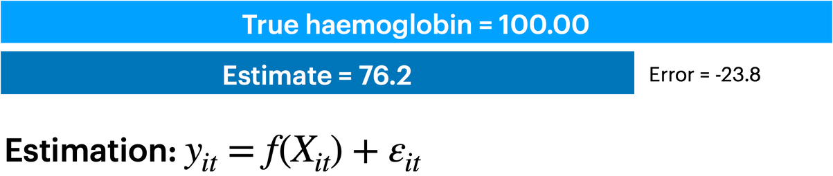
II
Methodology
Mixed-effects Machine learning
10
Notes:
On the screen you can see an example of a prediction when we use XGBoost and ANN regularly. The true hb value is 100, and we predicted it to be 76.2.

Slide 60
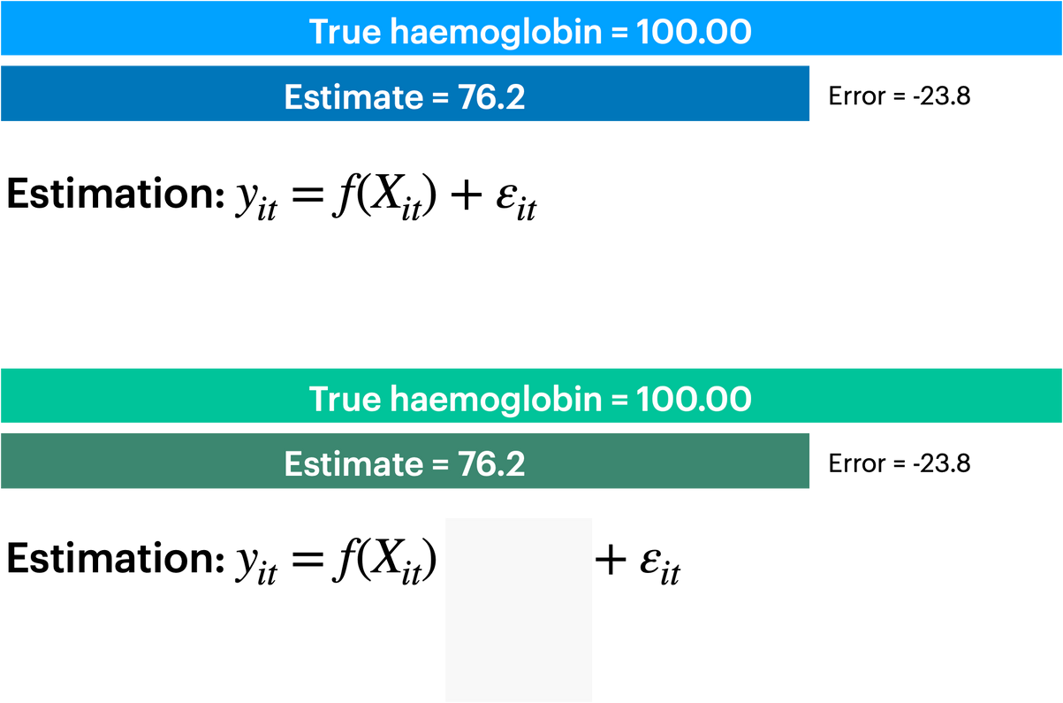
II
Methodology
Mixed-effects Machine learning
10
Notes:
Now consider a second estimation, which starts exactly the same as the normal machine learning estimation. But here's the difference, in mixed-effects machine learning we add an additional term.

Slide 61
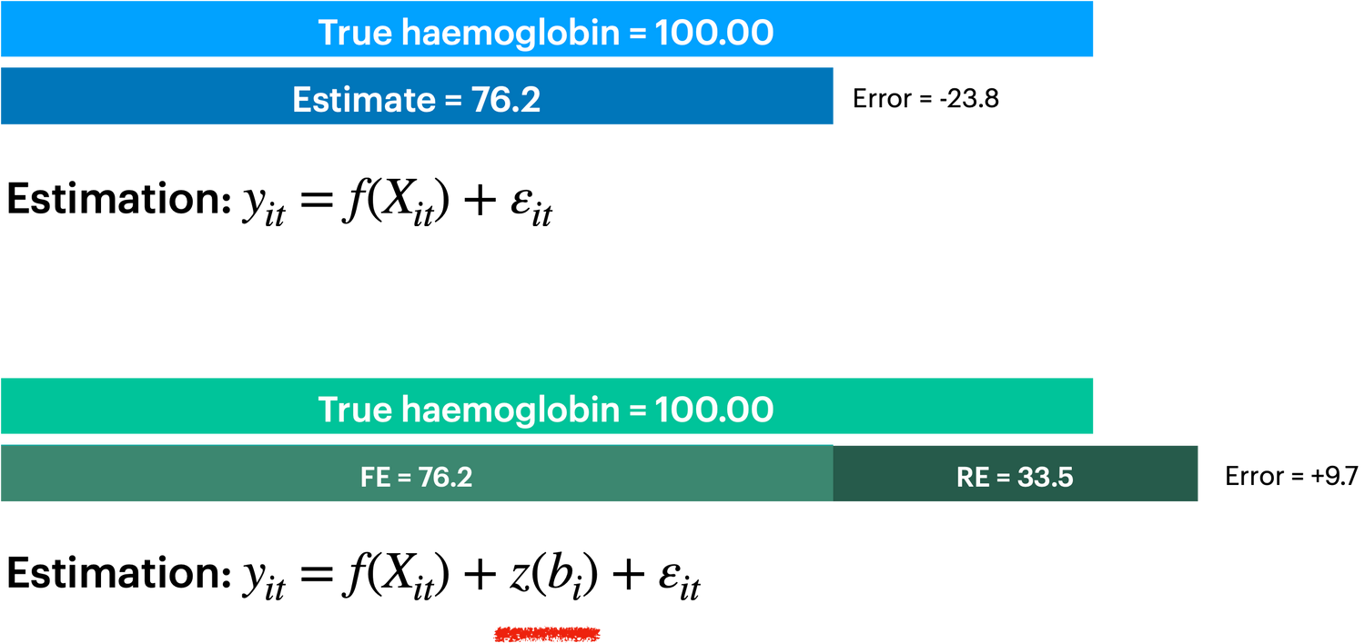
II
Methodology
Mixed-effects Machine learning
10
Notes:
This one. This term is individual specific, and aims to capture the intra individual correlations.

Slide 62
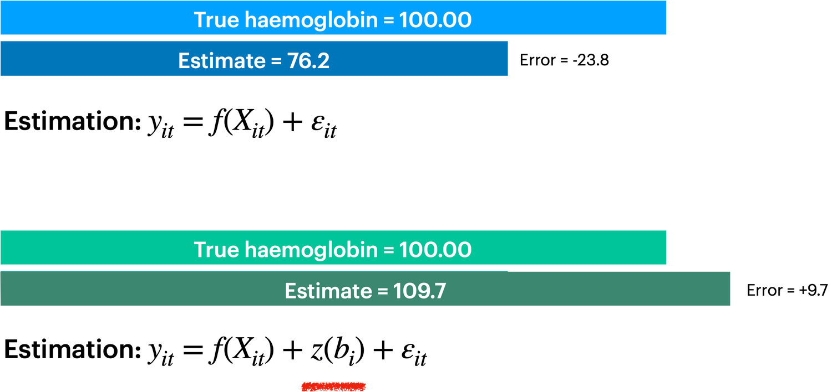
II
Methodology
Mixed-effects Machine learning
10
Notes:
And as you can see, in our perfect hypothetical situation, adding this term has lead to a better prediction. The question is now: does this also hold in practice?

Slide 63
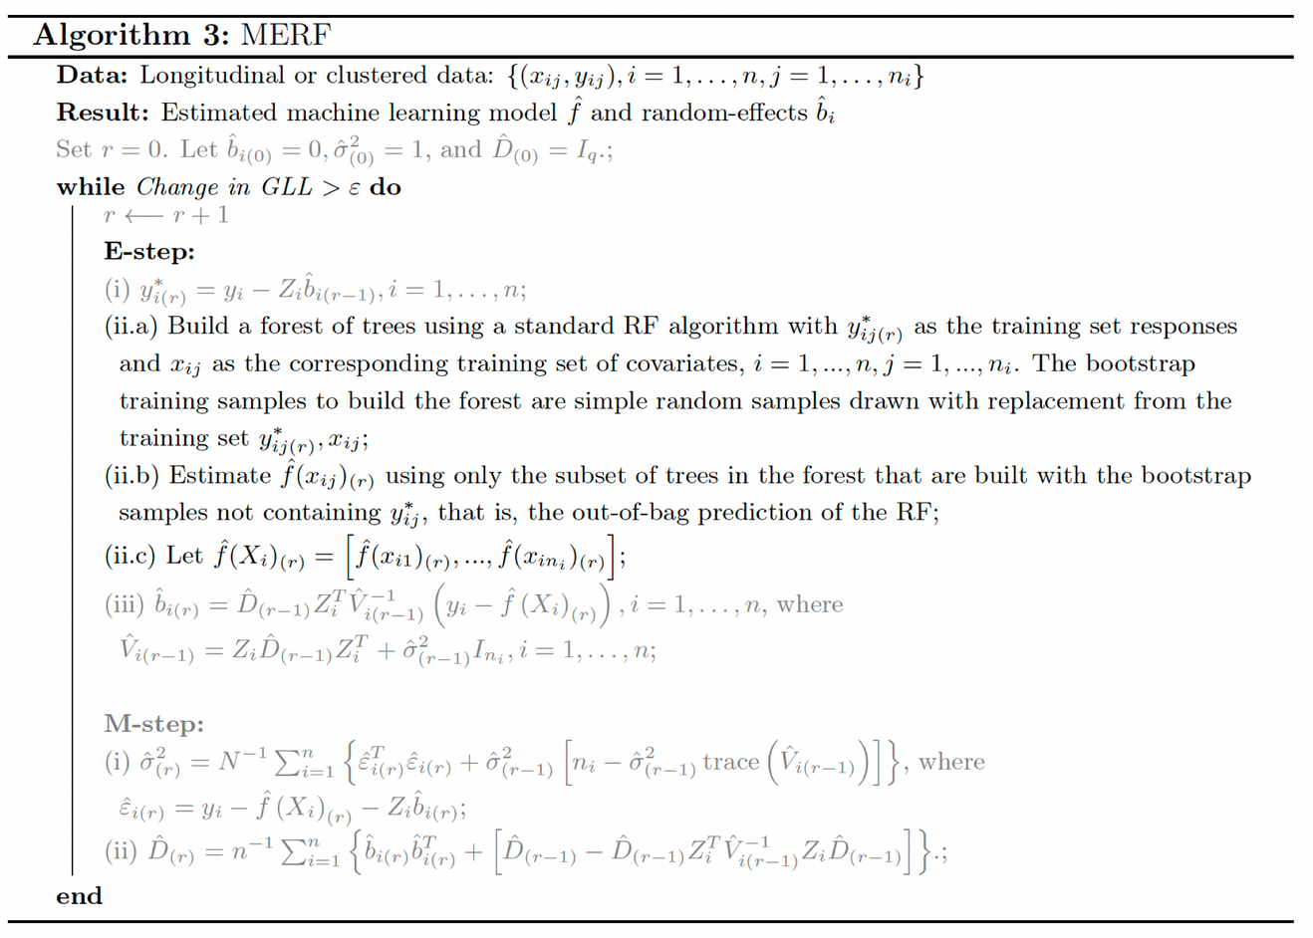
II
Methodology
Mixed-effects Machine learning
11
Notes:
Now, as you've noticed by now, I love to explain the mathematics behind algorithms. But no worries, I won't be explaining the algorithm as you're seeing it on the screen right now. Instead, I've simplified it.

